Slide 1
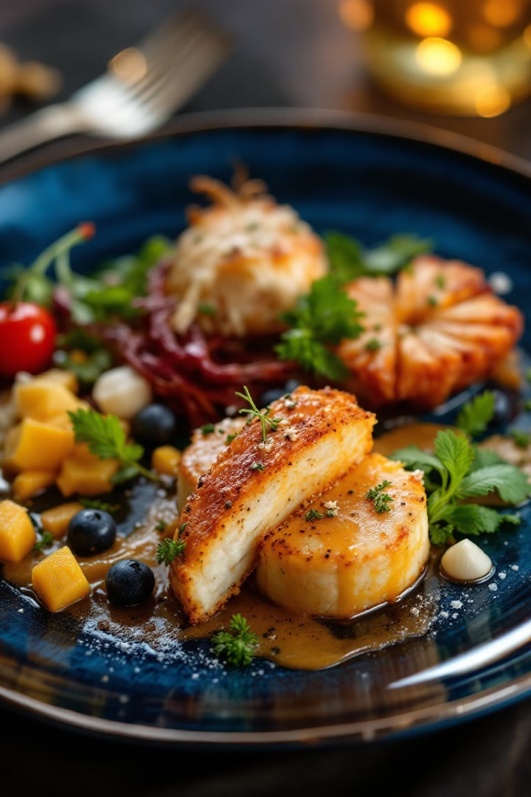
Personalized Culinary Recommendation Using Machine Learning
By:-
Under:- Dr. Prasad M [51325]
Atharva Rai [21BCE1055] Pabak Kundu [21BPS1629] Yash Premendra Sinha [21BPS1632]

Slide 2
Outline
Introduction
Problem Statement
Research Objectives
Proposed System
Proposed System Introduction
Proposed System Diagram
List of Modules
Module Explanations (Algorithms)
100% Implementation with Results
Next Steps
Guide Approval Snapshot
Research Paper Status
References

Slide 3
Introduction
Background: Food plays a crucial role in health and well-being. With advancements in machine learning, food recommendations can be personalized based on user preferences, sentiments, and health needs.
Need for Personalized Food Recommendation: Traditional systems focus only on preferences, but integrating sentiment analysis and nutrition makes recommendations more effective.
Machine Learning Impact: Real-time sentiment analysis through camera devices and alignment with nutritional requirements enhances user engagement.

Slide 4
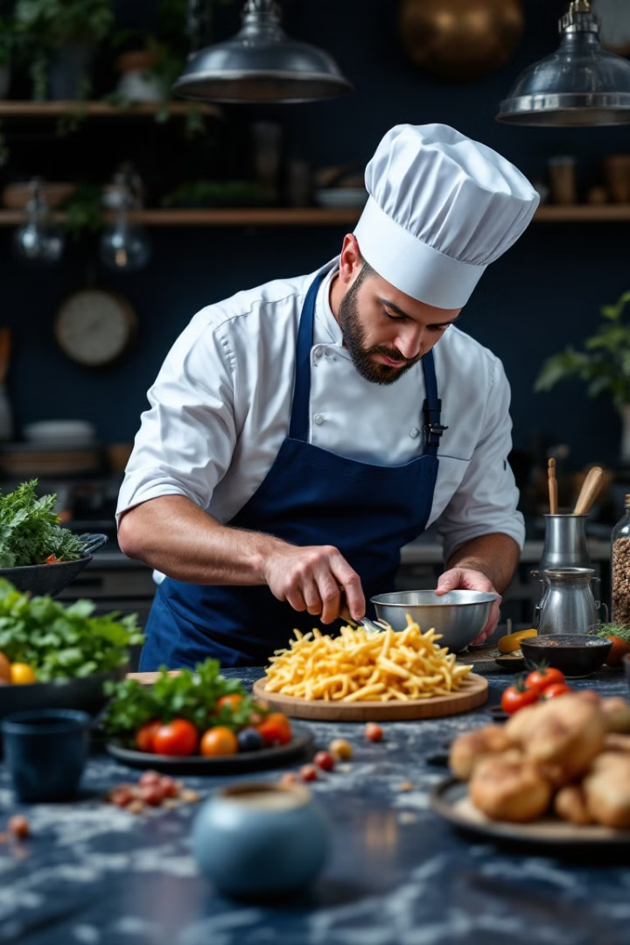
Problem Statement
Challenge:
Developing an efficient, integrated system capable of recommending recipes tailored to user preferences and health needs, while leveraging sentiment analysis through camera devices, presents challenges in data processing, model accuracy, and real-time system integration.

Slide 5
Statement of Problem/Challenges
Research Question
Significance
How can machine learning models effectively provide personalized culinary recommendations by analyzing user sentiment through camera devices and aligning with individual nutritional requirements?
Food choice plays a crucial role in health and well-being. With advancements in machine learning, it is now possible to personalize culinary experiences based on user preferences, sentiments, and health requirements. Integrating sentiment analysis with nutritional data can lead to more engaging and health-conscious food recommendation systems. The combination of user emotion, nutritional requirements, and technology presents significant opportunities for innovation.

Slide 6
Literature Survey-I
TITLE | AUTHOR(S) | ABSTRACT
INFLUENCE OF ARTIFICIAL INTELLIGENCE (AI) ON CUSTOMER EXPERIENCE AND LOYALTY: MEDIATING ROLE OF PERSONALIZATION | Ifekanandu, Christian Chukwudi et al. [2023] | This study explores how AI impacts customer experience and loyalty, with personalization as a mediator. It finds that AI positively influences customer experience, loyalty, and personalization.
Food Recipe Recommendation Based on Ingredients Detection Using Deep Learning | Md. Shafaat Jamil Rokon et al. [2022] | The paper proposes a deep learning model for food ingredient recognition and recipe recommendation. It uses a custom dataset and achieves high accuracy in ingredient detection and recipe suggestions.
Personalizing guest experience with generative AI in the hotel industry: there's more to it than meets a Kiwi’s eye | Pola Q. Wang et al. [2024] | This study examines the use of generative AI in New Zealand's hotel industry, highlighting its potential for cost savings and efficiency but also concerns about cultural fit and data privacy.
Addressing the complexity of personalized, context-aware and health-aware food recommendations: an ensemble topic modelling based approach | Mansura A. Khan, Barry Smyth, David Coyle et al. [2021] | The study proposes an ensemble topic modeling approach for personalized food recommendations, focusing on multi-domain preferences and efficient user modeling.

Slide 7
Literature Survey-II
TITLE | AUTHOR(S) | ABSTRACT
TITLE | AUTHOR(S) | ABSTRACT
Evolutionary food quality and location strategies for restaurants in competitive online-to-offline food ordering and delivery markets: An agent-based approach | Zhou He et al. [2019] | This research investigates how restaurants optimize food quality and location decisions in competitive O2O food markets using an agent-based model.
Mobile food ordering apps: An empirical study of the factors affecting customer e-satisfaction and continued intention to reuse | Baabdullah, Alalwan, Rana, Patil, Dwivedi et al. [2019] | The study examines factors influencing customer satisfaction and reuse intention for mobile food ordering apps in Jordan, using an extended UTAUT2 model.
Role of mobile food-ordering applications in developing restaurants' brand satisfaction and loyalty | Science Direct et al. [2021] | Analyzes the impact of Mobile Food-Ordering Apps (MFOAs) on customer satisfaction and brand loyalty, especially during the COVID-19 pandemic. Uses PLS-PM modeling for data analysis​.
Increasing customer service efficiency through artificial intelligence chatbot | Ivan Martins De Andrade, Cleonir Tumelero et al. [2022] | Examines AI chatbots' role in enhancing customer service efficiency in a Brazilian bank. Shows how chatbots reduce call center queues and improve response times using IBM Watson.

Slide 8
Literature Survey-III
TITLE | AUTHOR(S) | ABSTRACT
Smart Cook: An AI and Machine Learning Powered Culinary | Gora Kanijfatma Maisurali, Habiba Vajirali Momin, et al. [2024] | Introduces SmartCook, an AI-powered culinary assistant that provides personalized recipe recommendations based on user preferences, dietary restrictions, and available ingredients.
ChatDiet: Empowering personalized nutrition-oriented food recommender chatbots through an LLM-augmented framework | Zhongqi Yang, Elahe Khatibi, et al. [2024] | Proposes a chatbot-based food recommendation system using Large Language Models (LLMs) and causal inference to offer personalized nutrition advice.
AI-Powered in the Digital Age: Ensemble Innovation Personalizes the Food Recommendations | Chairote Yaiprasert, Achmad Nizar Hidayanto et al. [2024] | Investigates AI-powered meal services using ensemble learning techniques. Uses decision trees, logistic regression, and Naïve Bayes to personalize food recommendations.
Personalized Food Recommendation System using Machine Learning | M.S.N.V. Jitendra, Maddula Lakshmi Jyosna, et al. [2023] | Develops a personalized food recommendation system based on machine learning models such as Decision Trees, KNN, and Logistic Regression, considering user age and preferences.

Slide 9
Literature Survey-IV
TITLE | AUTHOR(S) | ABSTRACT
Personalized Diet Recommendation System Using Machine Learning | D. Navya Narayana Kumari, T. Praveen Satya, et al. [2023] | Focuses on developing a personalized diet recommendation system using machine learning techniques to suggest meal plans based on BMI, dietary restrictions, and health goals​.
AI CHEF: An Intelligent Culinary Expert Using Deep Learning | Hitha U Karkera, Sripada Adiga, et al. [2024] | AI-powered desktop application for recipe recommendations, leveraging deep learning and image recognition to assist users in cooking.
Artificial Intelligence and Machine Learning Technologies for Personalized Nutrition: A Review | Dimitris Tsolakidis, Lazaros P. Gymnopoulos, et al. [2024] | Provides a comprehensive review of AI and ML applications in personalized nutrition, covering data-driven recommendation systems and dietary analysis​.

Slide 10
Proposed System
1
2
User Sentiment Analysis
Recipe Recommendation
Detects user emotion via facial expressions. Uses FER for real-time analysis.
Collaborative and content-based filtering. Integrates user preferences and interaction history.
3
4
Web Integration
Data Storage and Retrieval
FastAPI for backend. React framework for frontend.
Database for storing user preferences and interactions.

Slide 11
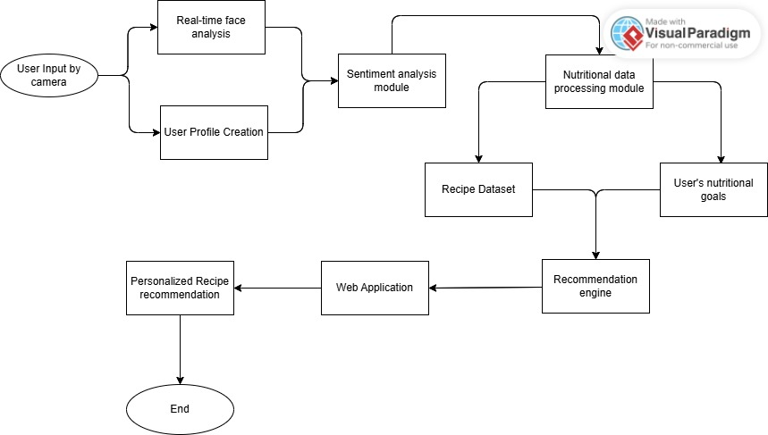
Proposed Block Diagram

Slide 12
List Of Modules
Sentiment Analysis Module
Recipe Recommendation Module
Integration Layer
RESTful APIs built using FastAPI. Frontend development with Streamlit for a user-friendly interface.
Algorithm: Convolutional Neural Networks (CNN) for facial expression analysis.
Collaborative Filtering and Content-Based Filtering. Also providing similar recipes recommendation after choosing a recipe using KNN , Cosine Similarity or any other appropriate model.

Slide 13
List Of Modules(explained)
Sentiment Analysis Module
User sentiment analysis is a crucial component of the system that detects real-time facial expressions to gauge user emotions while selecting food. By leveraging Convolutional Neural Networks (CNN), the system processes video input from the camera and classifies expressions into predefined sentiment categories such as happy, neutral, or dissatisfied. These sentiments are then mapped to food preferences to personalize recommendations. Challenges include accurate emotion detection in varying lighting conditions and diverse facial features. To enhance accuracy, the system is trained on large facial expression datasets and optimized for real-time processing.

Slide 14
List Of Modules(explained)
Recipe Recommendation Module
The recipe recommendation module employs Collaborative Filtering and Content-Based Filtering to suggest recipes that match user preferences and past interactions. It incorporates K-Nearest Neighbors (KNN) and Cosine Similarity to find similar recipes based on ingredient composition and user ratings. By analyzing historical choices and interaction patterns, the system provides a ranked list of personalized recipe suggestions. Continuous model improvement involves refining similarity calculations and incorporating reinforcement learning for adaptive recommendations based on user feedback.

Slide 15
List Of Modules(explained)
Integration Layer
The web integration module ensures seamless user interaction through a user-friendly interface developed with FastAPI for backend services and Streamlit for frontend visualization. The system is accessible via a web dashboard where users can input their preferences, view recommended recipes, and analyze sentiment-based meal suggestions. The backend handles API requests efficiently, processes sentiment analysis and nutritional data, and returns results in real-time. Future upgrades include mobile app integration and voice command support for enhanced accessibility.

Slide 16
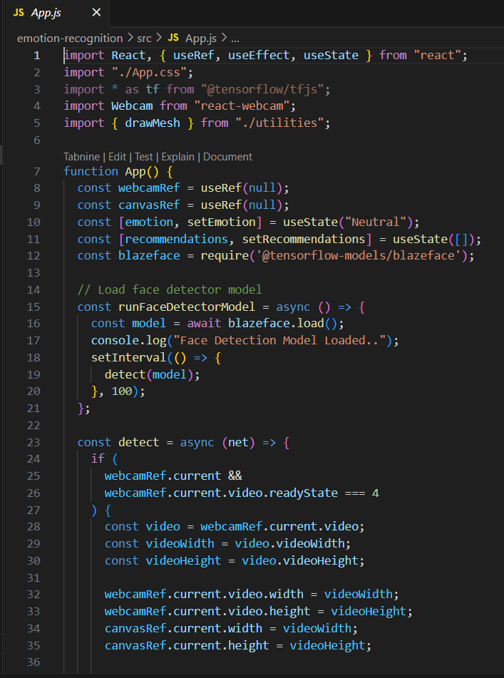
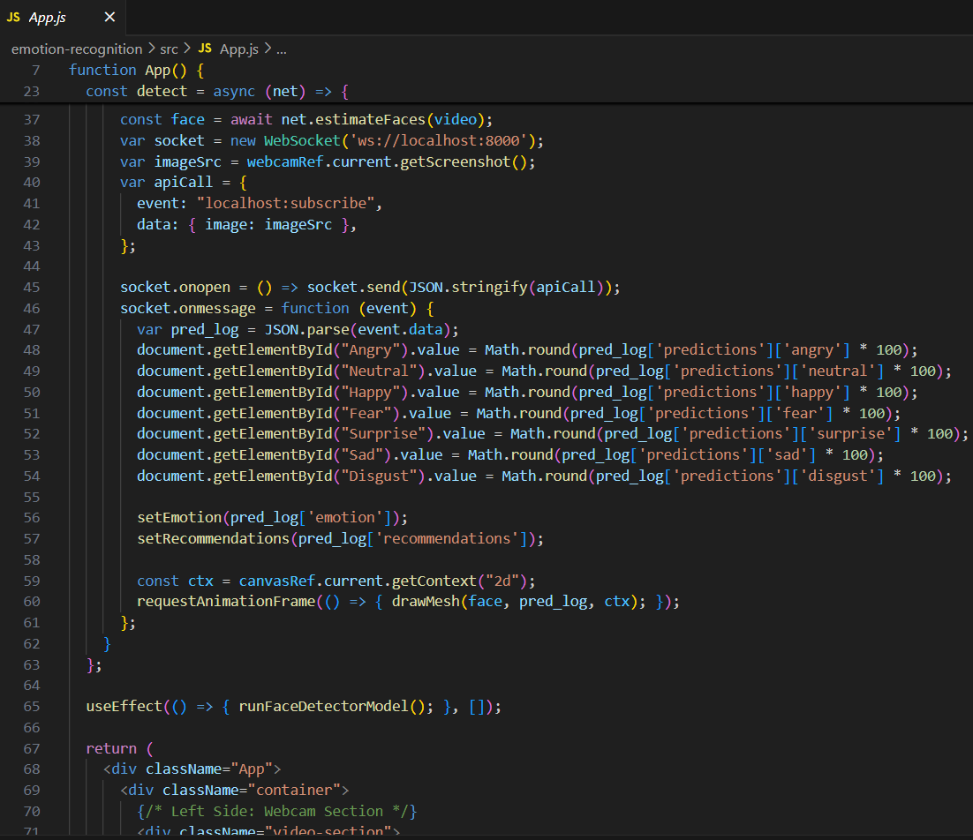
Implementation-Frontend

Slide 17
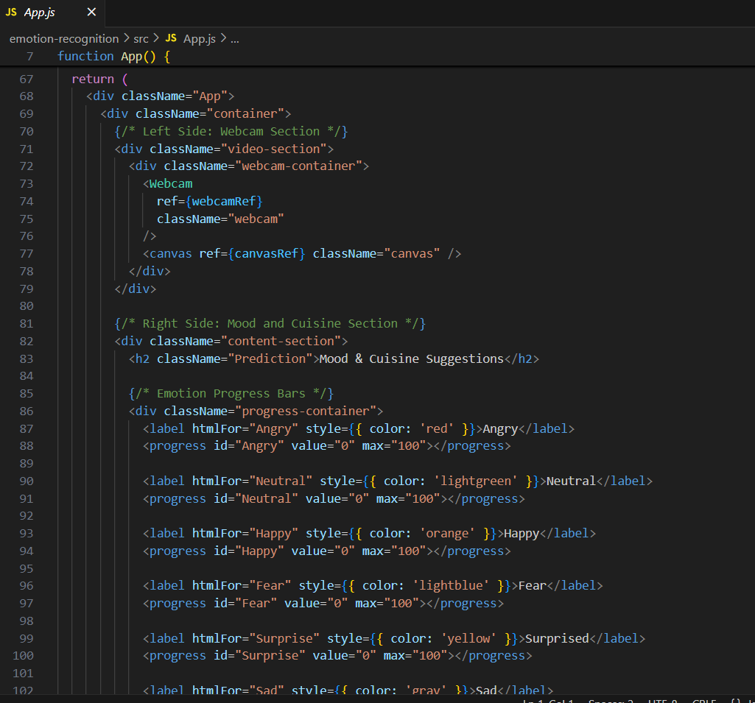
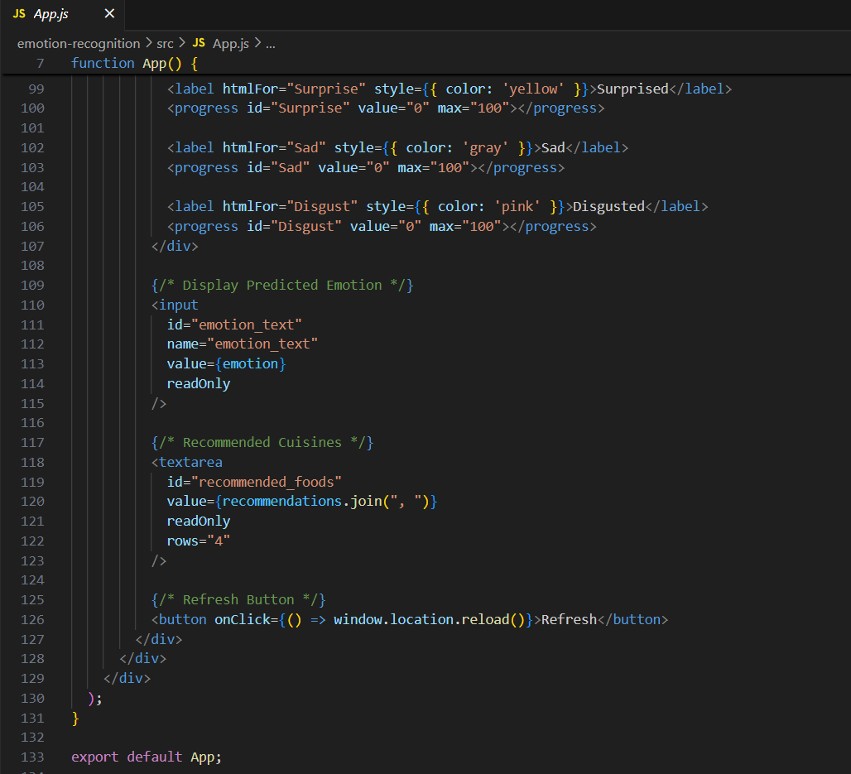
Implementation-Frontend

Slide 18
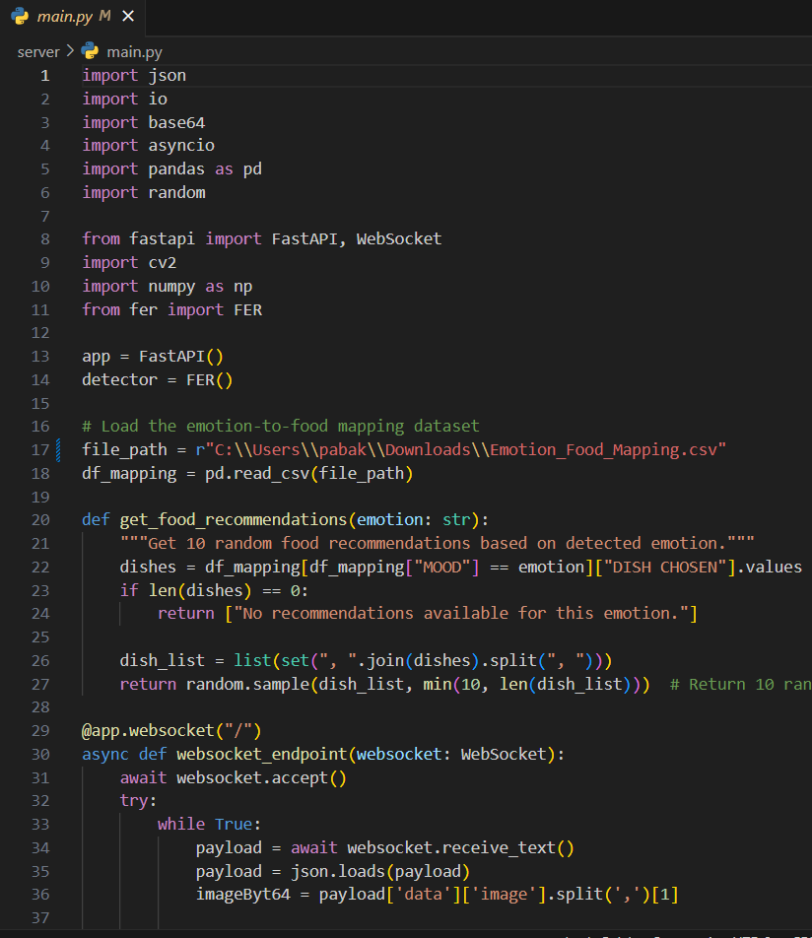
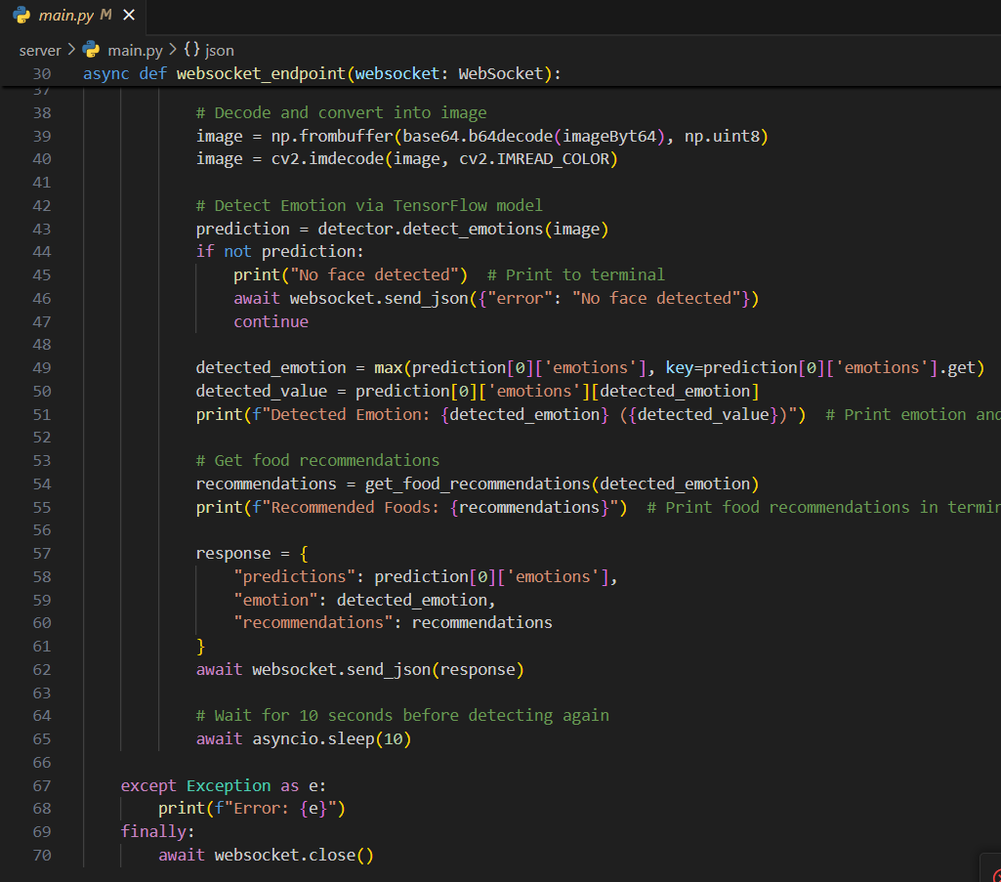
Implementation-Backend

Slide 19
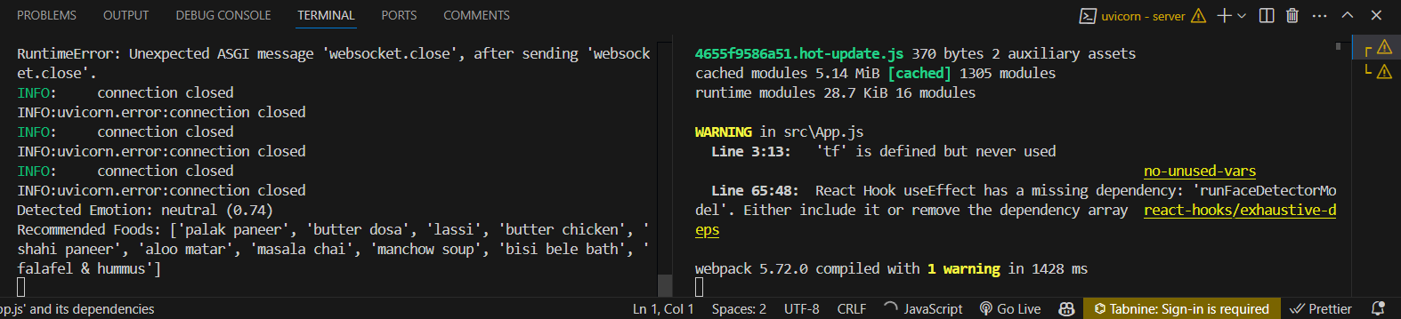
Implementation
Terminal Window Output

Slide 20
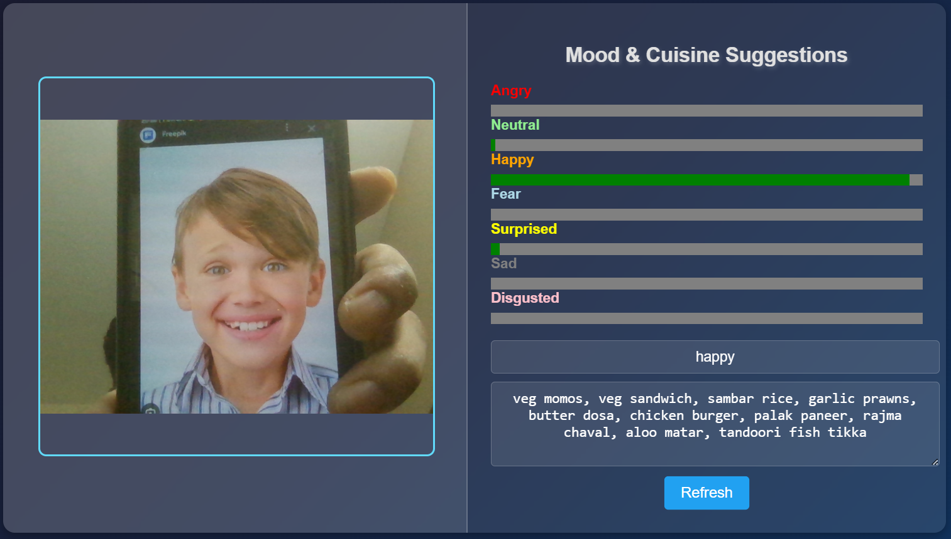
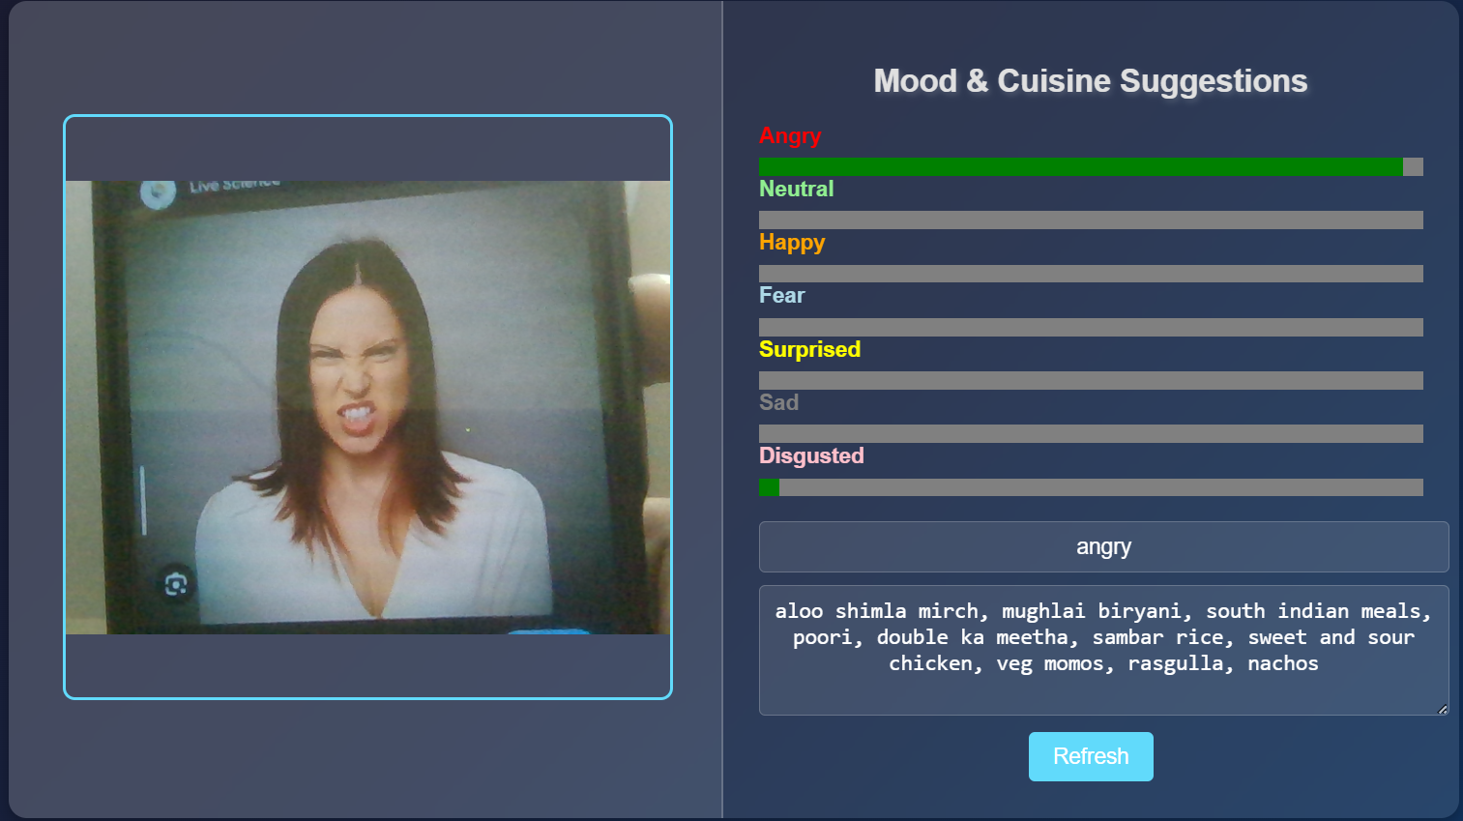
Results

Slide 21
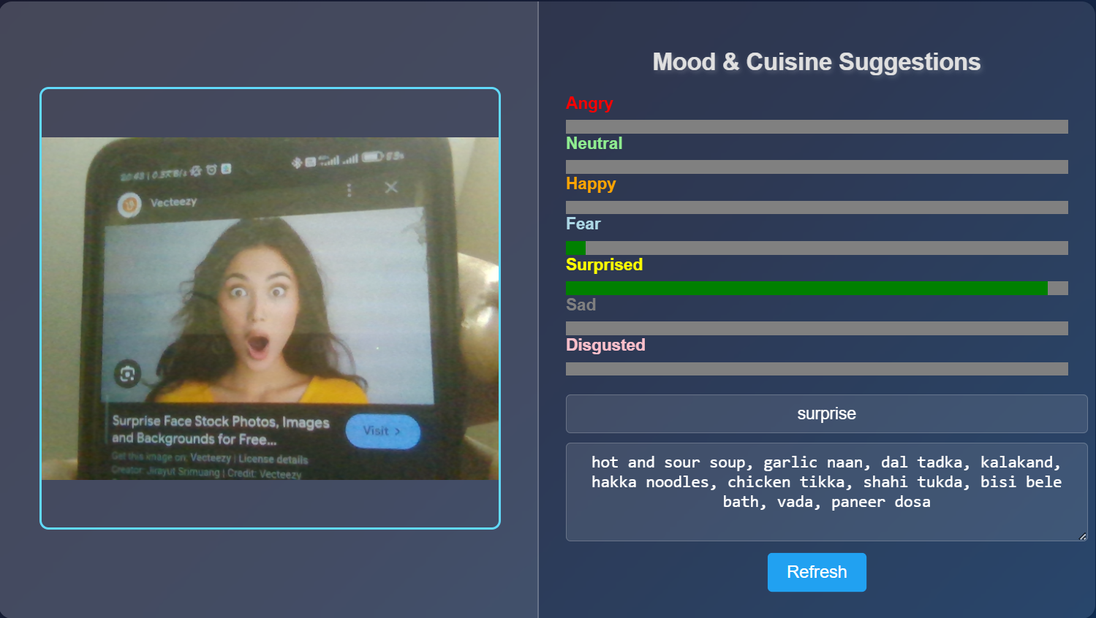
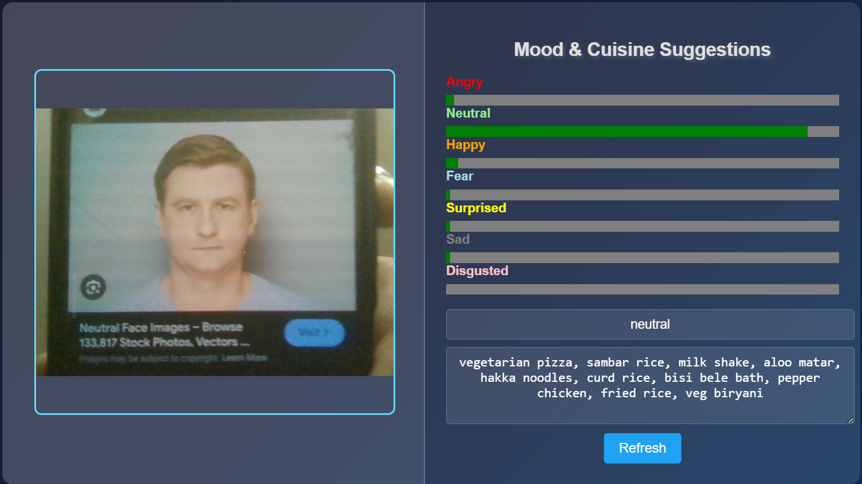
Results

Slide 22
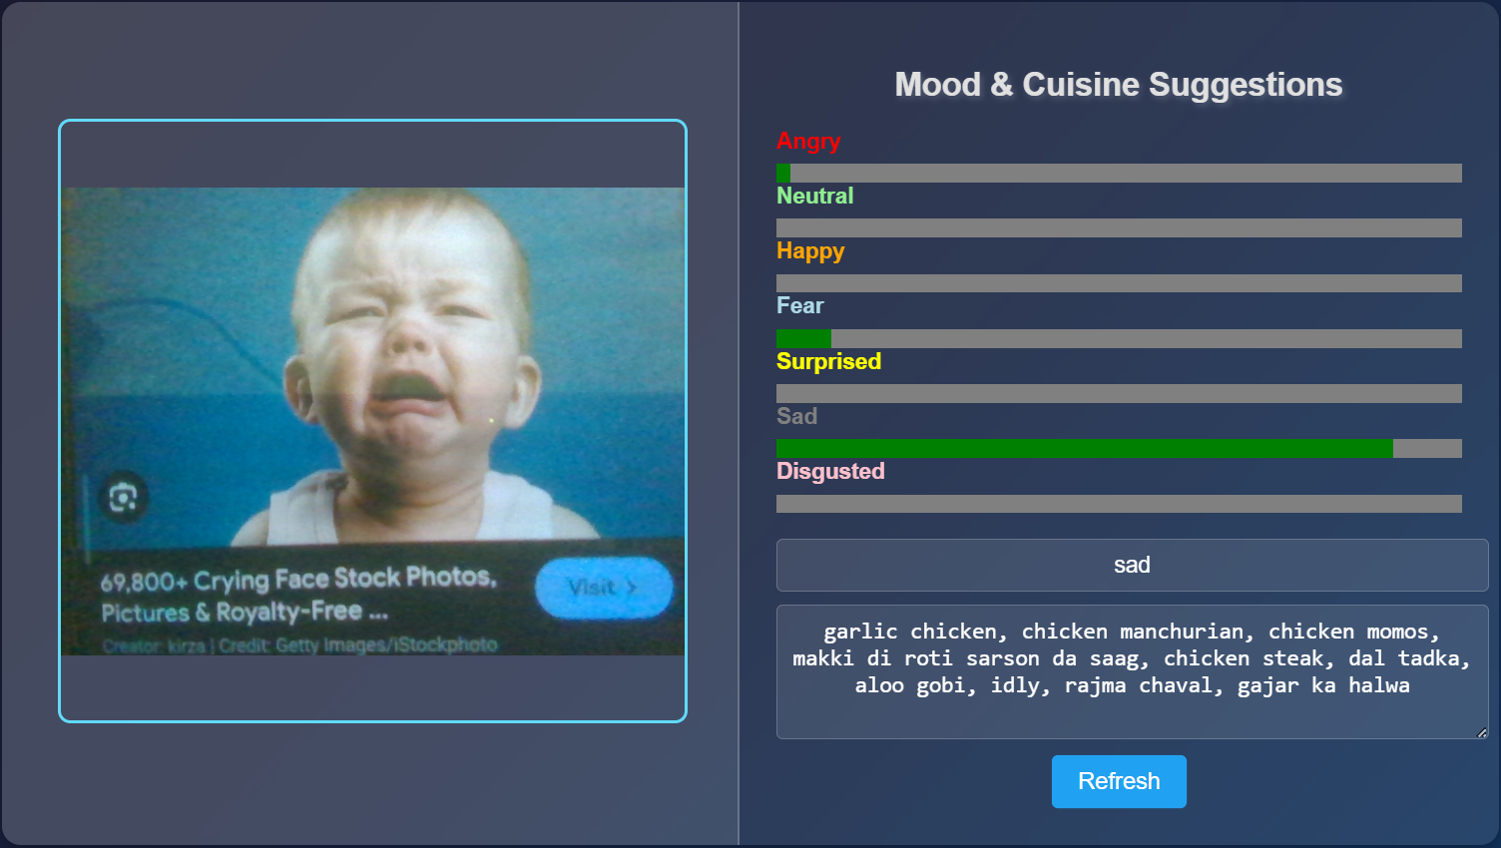
Results

Slide 23
Analysis Approaches
Preprocessing
1
Handling missing values, standardizing units.
Feature Engineering
2
Sentiment scores.
Finding Similarity
3
Use of KNN algorithm to find similar dishes.

Slide 24





Data Collection Approaches
Dataset
Advantage
Limitation
Potential Risk
Recipes and interactions from Zoho dataset.
Rich and diverse dataset covering a wide range of cuisines and user interactions.
Potential data imbalance and missing entries.
Misrepresentation of nutritional values.
Ethical Issues
Ensuring user privacy when collecting and processing camera data.

Slide 25
Research Challenges
Challenge 1
Challenge 2
Challenge 3
Extracting accurate sentiment data from live camera feeds.
Balancing user preferences.
Handling noisy, incomplete, or biased datasets.
Challenge 4
Challenge 5
Real-time integration of machine learning models with web technologies.
Ethical concerns related to data collection and user privacy.

Slide 26




Research Objective
1
Objective
Analyze User Sentiment
2
In real-time via camera devices.
Finding similar dishes
3
Use of classification algorithms.
Integrate Seamlessly
4
User-friendly web interface.

Slide 27





What is to be done next?
Fine-tuning Models
For higher accuracy.
Enhancing Sentiment Analysis
Real-time capabilities.
Expanding Dataset
For better generalization.
Classifying food based on Nutritional content
Scope of classifying certain foods as allergens based on ingredients and nutritional content.

Slide 28
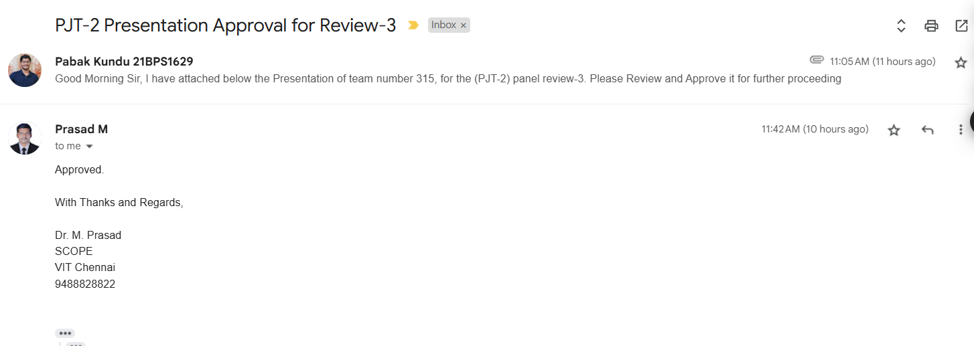
Guide Approval Snapshot

Slide 29
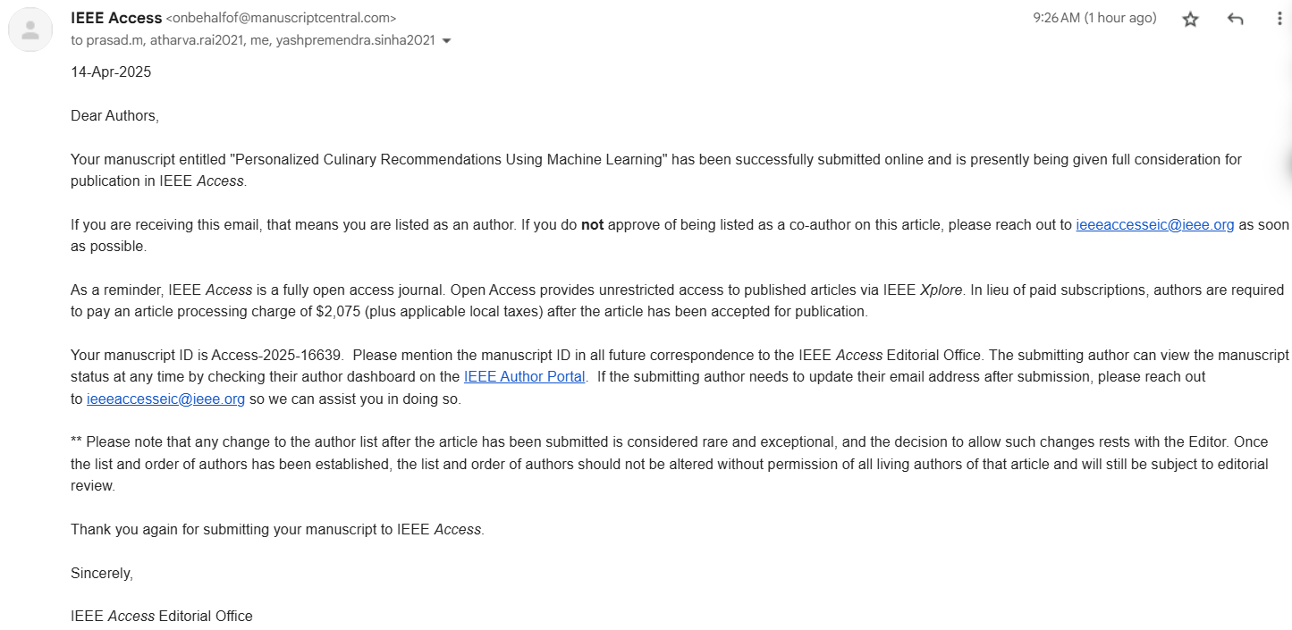
Research Paper Submission Snapshot

Slide 30
References-I
[1] Ifekanandu Chukwudi Christian, Cajetan Ewuzie, Chiemelie Benneth Iloka, et al. (2023). “Influence of Artificial Intelligence (AI) on Customer Experience and Loyalty: Mediating Role of Personalization”. Journal of Data Acquisition and Processing​.
[2] Md. Shafaat Jamil Rokon, Md Kishor Morol, et al. (2022). “Food Recipe Recommendation Based on Ingredients Detection Using Deep Learning”. International Conference on Computing Advancements (ICCA)​.
[3] Pola Q. Wang, et al. (2024). “Personalizing guest experience with generative AI in the hotel industry: there's more to it than meets a Kiwi’s eye”. ScienceDirect.
[4] Mansura A. Khan, Barry Smyth & David Coyle, et al. (2021). “Addressing the Complexity of Personalized, Context-Aware, and Health-Aware Food Recommendations: An Ensemble Topic Modelling-Based Approach.​.”
[5] Zhou He, Guanghua Han, T.C.E. Cheng, Bo Fan, Jichang Dong, et al. (2019). “Evolutionary Food Quality and Location Strategies for Restaurants in Competitive Online-to-Offline Food Ordering and Delivery Markets: An Agent-Based Approach”. International Journal of Production Economics​.
[6] Baabdullah, Alalwan, Rana, Patil, Dwivedi, et al. (2019). “Mobile Food Ordering Apps: An Empirical Study of the Factors Affecting Customer E-Satisfaction and Continued Intention to Reuse”. ScienceDirect​.
[7] ScienceDirect, et al. (2021). “Role of mobile food-ordering applications in developing restaurants' brand satisfaction and loyalty”. ScienceDirect​.

Slide 31
References-II
[8] Ivan Martins De Andrade & Cleonir Tumelero, et al. (2022). “Increasing customer service efficiency through artificial intelligence chatbot”. Revista de Gestão​.
[9] Gora Kanijfatma Maisurali, Habiba Vajirali Momin, et al. (2024). “Smart Cook: An AI and Machine Learning Powered Culinary”. International Journal of Scientific Research in Computer Science, Engineering and Information Technology​.
[10] Zhongqi Yang, Elahe Khatibi, et al. (2024). “ChatDiet: Empowering personalized nutrition-oriented food recommender chatbots through an LLM-augmented framework”. Smart Health​.
[11] Chairote Yaiprasert & Achmad Nizar Hidayanto, et al. (2024). “AI-Powered in the Digital Age: Ensemble Innovation Personalizes the Food Recommendations”. Journal of Open Innovation: Technology, Market, and Complexity​.
[12] M.S.N.V. Jitendra, Maddula Lakshmi Jyosna, et al. (2023). “Personalized Food Recommendation System by using Machine Learning Models”. International Journal of Innovative Science and Research Technology​.
[13] D. Navya Narayana Kumari, T. Praveen Satya, et al. (2023). “Personalized Diet Recommendation System Using Machine Learning”. SSRN​.
[14] Hitha U Karkera, Sripada Adiga, et al. (2024). “AI CHEF: An Intelligent Culinary Expert Using Deep Learning”. International Journal of Advanced Research in Computer and Communication Engineering​.
[15] Dimitris Tsolakidis, Lazaros P. Gymnopoulos, et al. (2024). “Artificial Intelligence and Machine Learning Technologies for Personalized Nutrition: A Review”. Informatics​.

